Slide 1
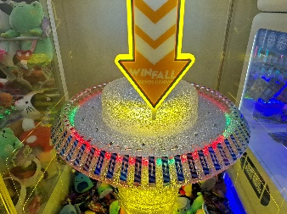
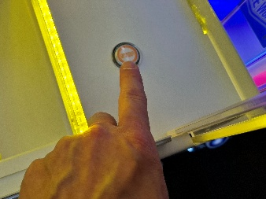
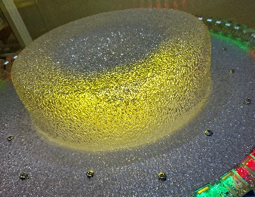
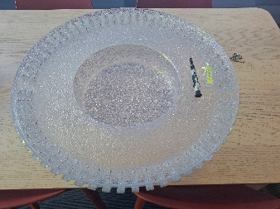
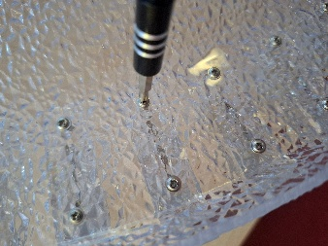
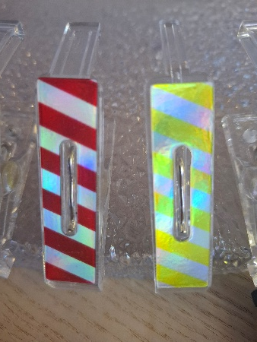
SKILL FALL REVOLUTION
Changing a peg
How to change a peg on Skill Fall Revolution
To change the pegs on Skill Fall, you need to remove the top wheel
Press the wheel stop button
Remove the 16 fixings around the top of the wheel
Place the wheel upside on a flat surface
To remove a peg, remove the 2 fixings with a size 0 Phillips.
Install the new peg using the same 2 fixings
Pegs shown for reference
Left: 9mm / 0.35" – Small Peg - fitted as standard on production
Right: 5mm / 0.2" – Micro Peg - New optional peg

